Slide 1
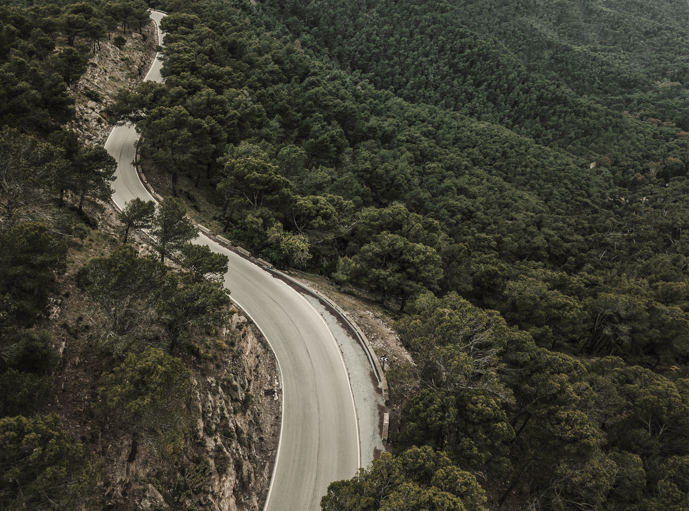
ENERGY
MANAGEMENT

Slide 2
ENERGY MANAGEMENT
01
WSN
02
TABLE OF CONTENTS
MODEL
03
SNEAK PEEK
04
PROJECT STAGES
05
Definition , Why is important?,Uses
Definition, Energy management in WSN.
Datasets , Models used , Parameters.
Results, Interpretation
Usage in other scenarios and Relevance.

Slide 3

ENERGY MANAGEMENT
It includes planning and operation of energy production and energy consumption units. Objectives are resource conservation, climate protection and cost savings, while the users have permanent access to the energy they need

Slide 4
Definition:
Importance :
WHAT IS ENERGY MANAGEMENT ?
Why do we need it?
How to ?
Energy management is a process of monitoring,controlling and conserving energy.
Much of the importance of energy saving stems from the global need to save energy - this global need affects energy prices, emissions targets, and legislation, all of which lead to several compelling reasons why you should save energy .
Reduce Costs
Reduce Carbon emissions
Reduce Risk
Metering Consumption.
Quantifying opportunities to save energy
Targeting and Tracking progress to save energy

Slide 5
What is WSN ?
Usage :
WHAT IS ENERGY MANAGEMENT IN WSN?
Why do we need it?
Why am I doing this ?
Wireless sensor network (WSN) refers to a group of spatially dispersed and dedicated sensors for monitoring and recording the physical conditions of the environment and organizing the collected data at a central location.
Area Monitoring
Earth Sensing
Threat Detection etc.,
Many sensors are redundant because their readings are spatially and temporally correlated and are predictable from the readings of a few other sensors in the network.To reduce the network by managing energy and life-time of network
A similar kind of Energy management model can used commercial power supply station at the time of shortage
This can be used to reduce carbon footprint of an organisation.

Slide 6
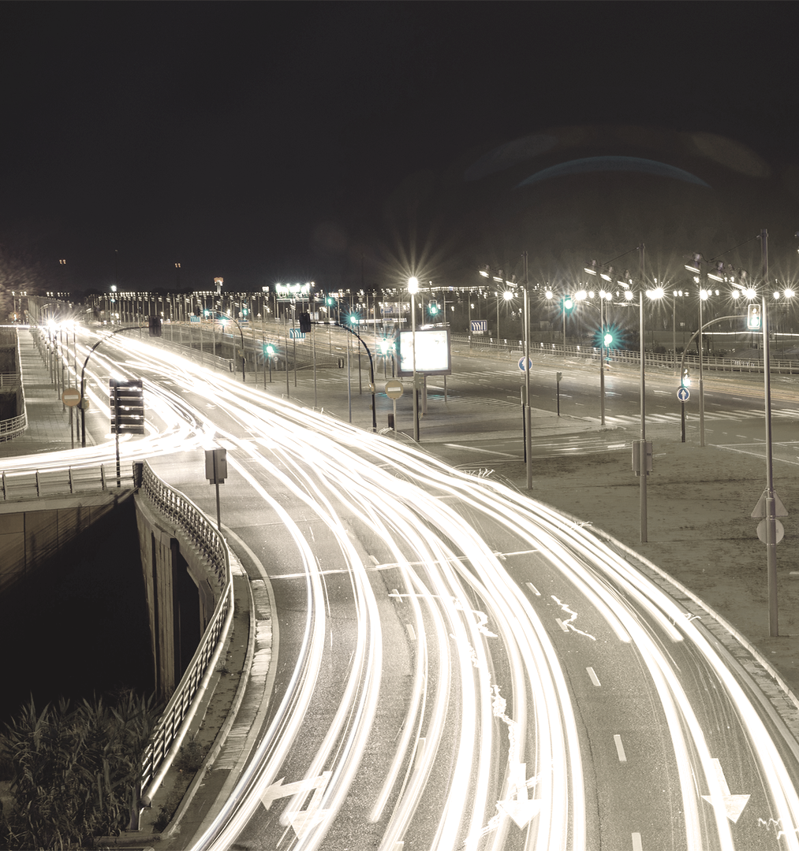
ABOUT THE PROJECT
This is model of sensor selection method using a unsupervised neural network structure that aims to reconstruct all sensor readings from a select few.

Slide 7

“Here comes the quote. Words full of wisdom that someone important said and can make the reader get inspired.”
—SOMEONE FAMOUS

Slide 8
Model
Dataset: (Source-Kaggle)
Ionosphere dataset : This data is from radars which monitors Ionosphere.
Forest Cover Type : This dataset includes information on tree type, shadow coverage, distance to nearby landmarks (roads etcetera), soil type, and local topography.
Model:
Each dataset is randomly shuffled and split into 70% and 30% training and testing set, respectively. Adam optimizer with batch size of 5/100 was used to train the model for 1000 epochs.
This model a simple neural network to learn to learn efficient data codings in an unsupervised manner with a mean square error loss.
Using partly-informed sparse autoencoder (PISAE) that reconstructs all sensor readings from readings of select few our model predict the effective no.of sensors
The hidden activations of PISAE were extracted and fed into a Softmax layer.

Slide 9
Model
All datasets were normalized for training PISAE model and decoder output mapped back to the original data interval for efficient reconstruction of the original data.
The hidden activations of PISAE are rounded to a low precision during the training to train faster
For Ionosphere Model:
*Learning rate : 0.01 ,batch size = 5 ,regularization constant: 0.001
For Forest cover model:
Learning rate :0.9 , batch size :100, regularization constant: 0.01

Slide 10

RESULTS & CONCLUSION

Slide 11
Results
Many sensors are redundant because their readings are highly correlated, lifetime can be enhanced by putting sensors with redundant readings to sleep without losing significant information
For Ionosphere dataset :
* No. of sensor decreased from 34 to 24 when threshold of 0.5 is used.(Lifetime Extension Factor = 1.42
For Forest cover dataset
* No.of sensors decreased from 54 to 41 (Lifetime Extension Factor = 54/41 =1.317

Slide 12
Conclusion & Implication
Our model can be applied on any sparse dataset.
Our main of this model is to decrease the power consumption in any organisation or household.
This can used for water monitering , Earth sensing etc
Like in factories which machine work at a time to increase productivity ,life-time, with decreasing carbon footprint and cost.
Monitoring the quality and level of water includes many activities such as checking the quality of underground or surface water and ensuring a country’s water infrastructure for the benefit of both human and animal. It may be used to protect the wastage of water.with less number of sensors and power we can monitor data with high productivity

Slide 13

THANKS
Abhilash Reddy .S
180102068
Umiam Hostel
Kriti -2019

